Slide 1
Touch For Food Stakeholder Presentation
CloudNine

Slide 2
Agenda
Original Backlog
Description and update of each story
Demo
Questions?

Slide 3
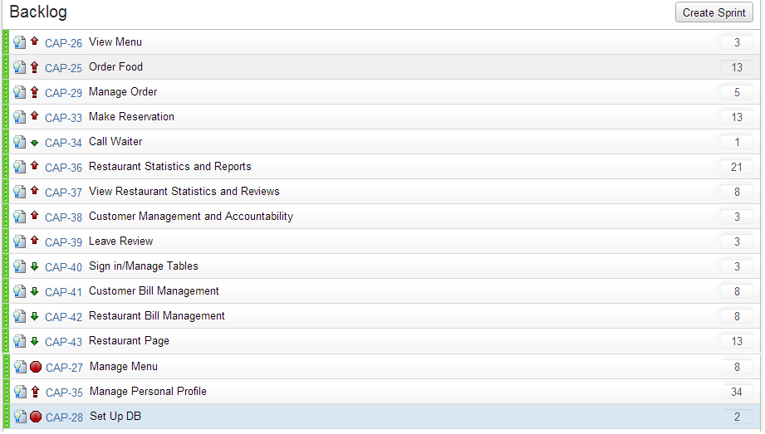
Original Backlog

Slide 4
Users
Customer
Restaurant
Waiter
Developer

Slide 5
Manage Menu
8 story points
Status: Complete
For user: Restaurant
Description: Create, update, delete, mark as inactive menus for your own restaurant

Slide 6
Manage Personal Profile
34 story points
Status: Partially Complete/Scoped Out
For user: Customer
Description: Create, edit user. Manage social networking page (reviews, order history, friends)

Slide 7
View Menu
3 story points
Status: Open
For user: Customer
Description: View menu, categories, item details, search

Slide 8
Order Food
13 story points
Status: Complete
For user: Customer
Description: Add item to order, place order, change order

Slide 9
Manage Tables
3 story points
Status: Complete
For user: Restaurant, Customer
Description: NFC tag or QR tap, assign table

Slide 10
Sign In
3 story points
Status: Complete
For user: All users
Description: After login to TFF, the appropriate options should be available based on user role

Slide 11
Call Waiter
1 story points
Status: Open
For user: Customer, Waiter
Description: A customer should be able to summon a waiter with the press of a button. A waiter should see all alerts for tables that have made a call.

Slide 12
Restaurant Bill Management
8 story points
Status: Complete
For user: Waiter, Restaurant
Description: A waiter should be able to separate any order items from various orders from a single table and put them on any number of bills.

Slide 13
Customer Bill Management
8 story points
Status: Open
For user: Customer
Description: A customer should be able to split his order into any number of bills.

Slide 14
Toppings and Sides
8 story points
Status: Open
For user: Restaurant
Description: As a restaurant, one should be able to associate side dishes (ex. Fries or salad) and toppings (ex. Lettuce, tomato, etc.)

Slide 15
Leave Review
3 story points
Status: Open
For user: Customer
Description: A customer should be able to review an item that he/she has ordered.

Slide 16
Scoped Out Stories
Restaurant Page
Customer Management and Accountability
View Restaurant Statistics and Reviews
Manage Personal Profile

Slide 17
To Do
User History
Mobile Phone wrappers
NFC and QR
UI
Flow
Restaurant Statistics and Reports? (last priority)

Slide 18
Organization of Ordered items

Slide 19
Questions?

